Slide 1
Enhancing Agent Reliability in Interactive Tool-Calling Environments via Test-Time Scaling
Team Members: Jahnvi Seth, Pranesh Somasundar, Lekshman Babu Devendra Babu, Sravanakumar Sathish, Samudyata Sudarshan Jagirdar
Group name: PromptOps
Mentor name: Amir Saeidi

Slide 2
Introduction
Problem: LLM agents frequently make unreliable decisions in multi-step tasks requiring planning, validation, and rule adherence
Approach: We explore test-time scaling to enhance reasoning during inference rather than retraining models
Implementation: Evaluated 5 strategies - Best-of-N, TTI, Budget Forcing, DBS and SVR on the tau-bench benchmark
Key Results: These methods reduced premature actions, prevented invalid tool calls, and enhanced multi-step reasoning capabilities

Slide 3
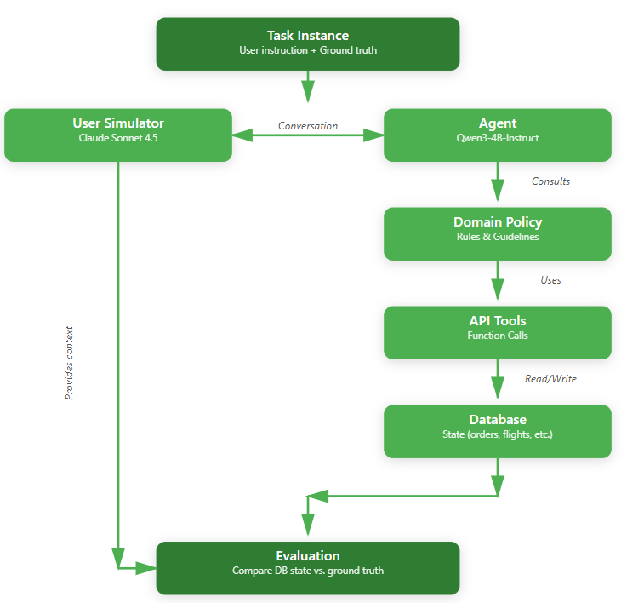
Tau-Bench
A Benchmark for Tool-Agent-User Interaction in Real-World Domains
Dynamic conversations between a user and a language agent provided
Two Environments: Retail and Airline
User Simulator: ReAct instead of tool-calling

Slide 4
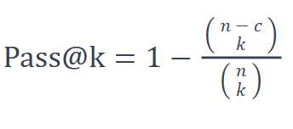
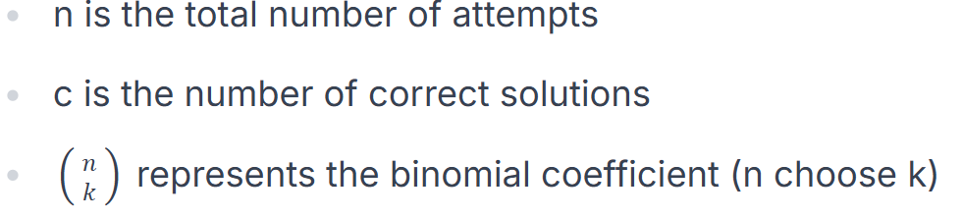
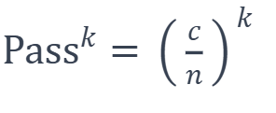
Evaluation Metric: Pass@k vs Pass^k
Pass@k measures the probability that at least one of k independent solution attempts will succeed.
Pass^k estimates the probability that an agent would succeed on all k independent attempts.
Where c/n represents the raw success rate on a single attempt

Slide 5
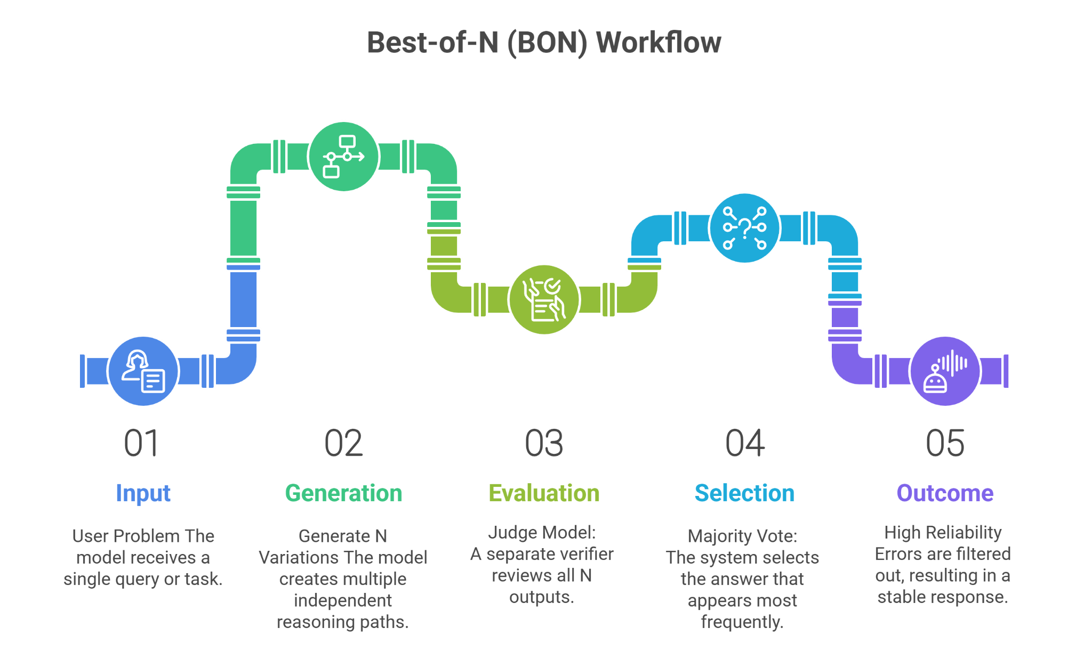
Method : Best of N
Multi-Path Generation
Generates N unique reasoning paths for a single problem.
Allows the model to explore diverse solution strategies simultaneously.
Judge-Based Evaluation
A separate "Judge Model" reviews all N generated outputs.
Identifies the most consistent reasoning across the variations.
Consensus Selection
Selects the answer supported by the majority (filtering out random noise).
Key Benefits
Reduces error rates and hallucinations.
Significantly improves reasoning stability and reliability.

Slide 6
Experiments
Experimental Configuration
Agent Model: Qwen 3 - 4B - Instruct.
User Model: Claude 4.5 Sonnet.
Metric: Average Reward (Pass^1).
Domain | Total Tasks | Successful Tasks | Success Rate | Outcome
Retail | 115 | 14 | 12.2% | Modest Success (Agent resolved refund/exchange tasks)
Airline | 50 | 4 | 8.0% | Significant Failure (Struggle with multi-step bookings)
Airline
Shunyu Yao, Noah Shinn, Pedram Razavi, and Karthik Narasimhan. τ -bench: A benchmark
for tool-agent-user interaction in real-world domains, 2024.

Slide 7
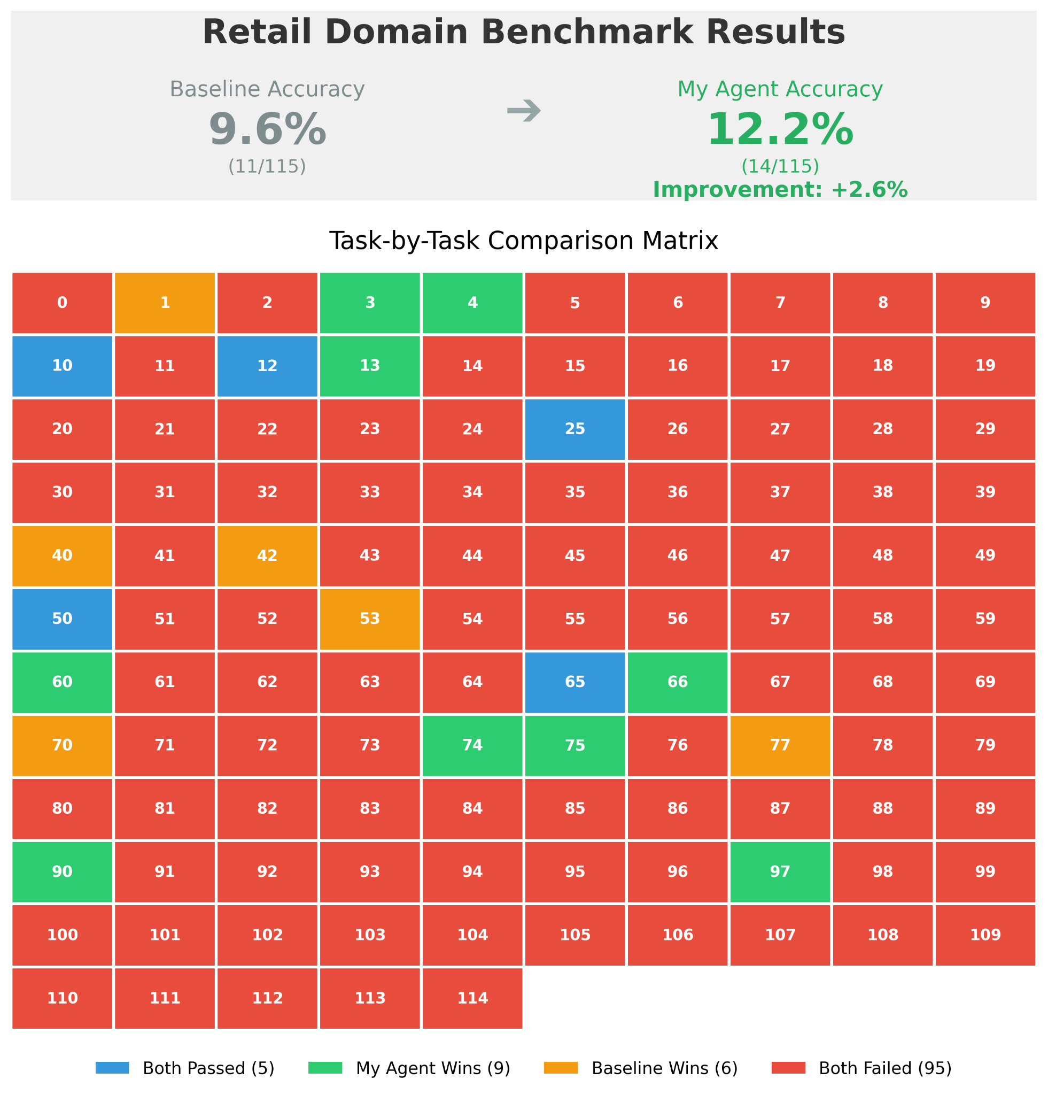
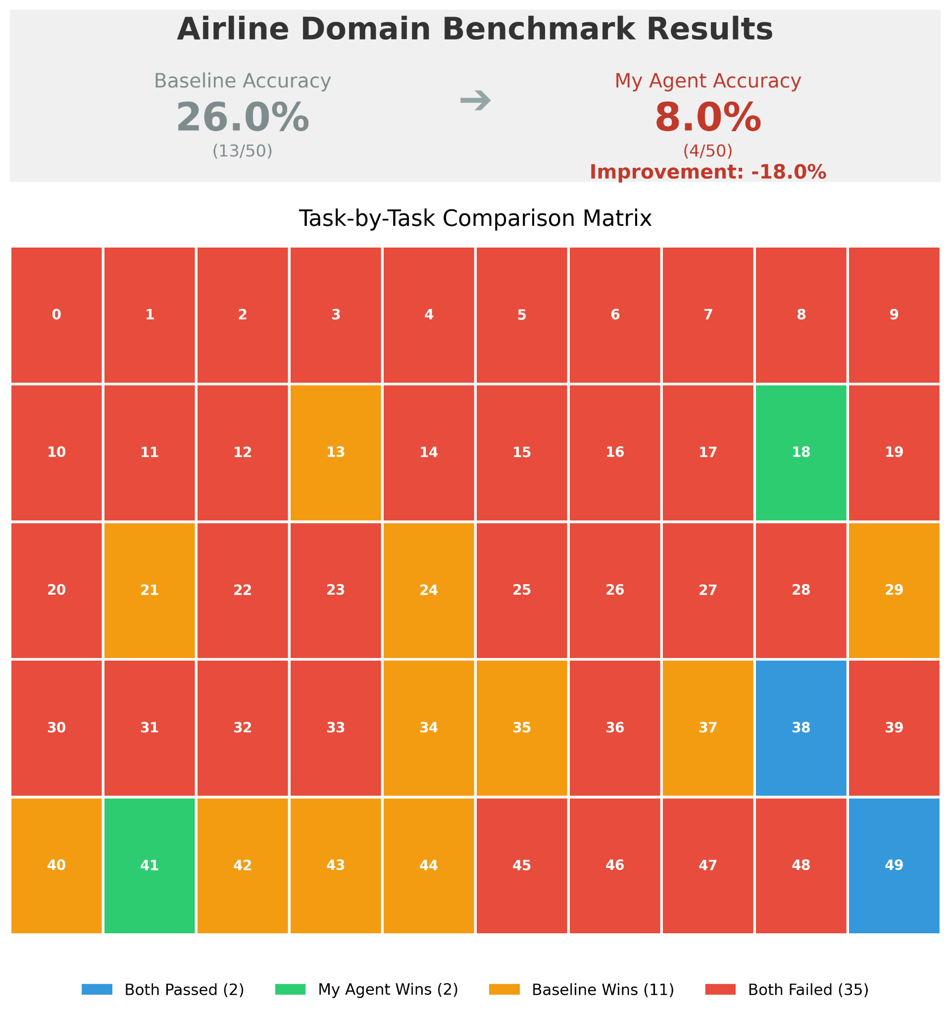
Findings

Slide 8
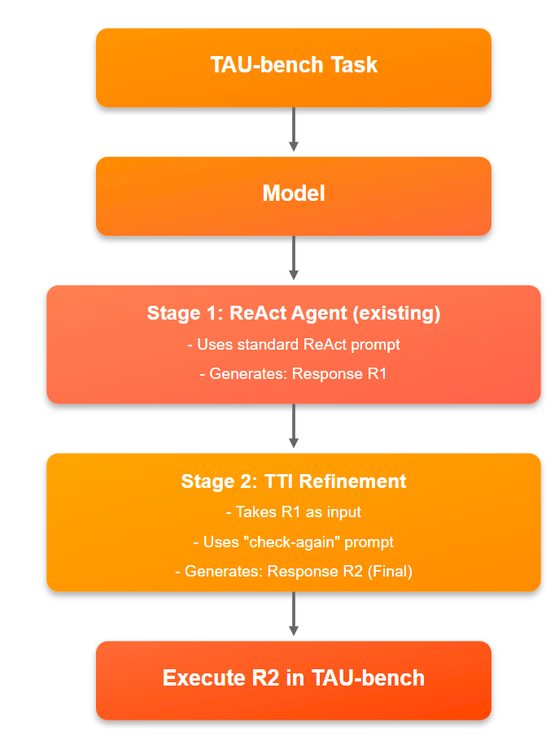
Method: Test Time Interaction
Not just ‘thinking more”
Agent interacts with its own output
A purely inference time “check-again” mechanism is used.
Reconsider its decision : “You just signaled task completion. Let’s pause and think again...”
We can extend re-checking from double-check (two passes) to four passes six passes

Slide 9
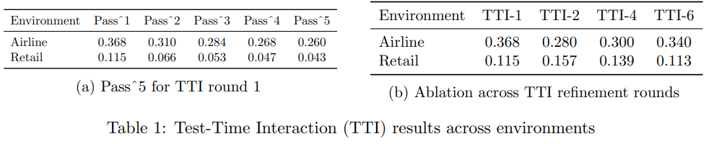
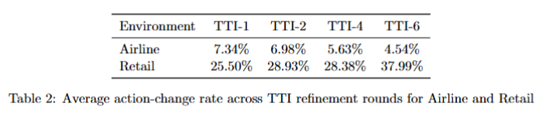
Results

Slide 10
Findings
TTI is far more effective in simpler, more structured environments.
Low change rates in Airline show that the model’s first guess is usually reliable
High change rates in Retail indicate susceptibility to over-refinement.
Future work should explore adaptive or task-aware refinement to better handle multi-step, high-dependency tasks.

Slide 11
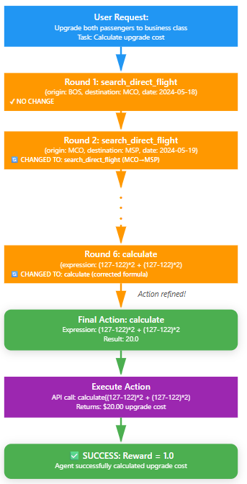
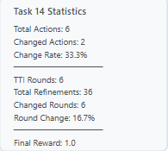
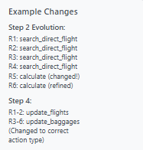
Example for TTI-6 Airline
{
"role": "assistant",
"content": "Thought:\nI have now searched for both flight segments to obtain business class prices. With both prices, I can calculate the cost difference for upgrading two passengers. \nAction:\n{\"name\": \"calculate\", \"arguments\": {\"expression\": \"(127 - 122) + (127 - 122) * 2\"}}"
},
{
"role": "user",
"content": "You just decided to take this action:\n {\"name\": \"calculate\", \"arguments\": {\"expression\": \"(127 - 122) + (127 - 122) * 2\"}}\n \n WAIT - Refinement round 6/6. Before executing, let's verify:\n 1. Does this action follow the policy and task requirements?\n 2. Have you gathered all necessary information?\n 3. Is there a more effective action you could take?\n \n Respond with your decision in this exact format:\n Thought:\n <One-line reasoning about whether to keep or change the action>\n Action:\n {\"name\": <action_name>, \"arguments\": <arguments>}\n \n If you decide to KEEP the original action, just repeat it. If you decide to CHANGE, provide the new action.\n "
},
{
"role": "assistant",
"content": "Thought:\nThe calculation is incorrect because it does not account for both segments and both passengers properly. The correct expression should compute the price difference per segment and multiply by two passengers. \nAction:\n{\"name\": \"calculate\", \"arguments\": {\"expression\": \"(127 - 122) * 2 + (127 - 122) * 2\"}}"
},
{
"role": "user",
"content": "API output: 20.0"
},

Slide 12
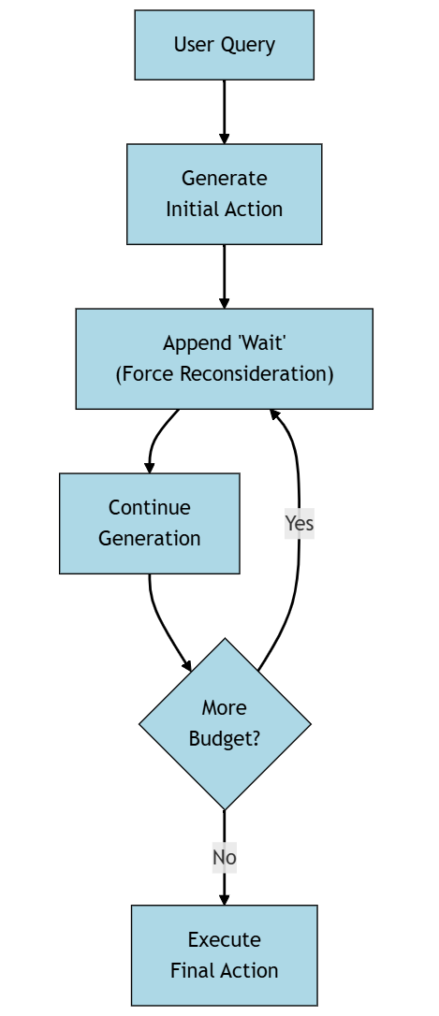
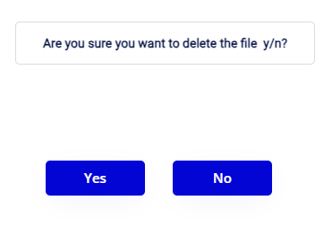
Method: Budget Forcing
The Process:
Analogy: Humans thinking twice before taking some actions
Mechanisms:
1. Early Termination (Force Answer):
Logic: Reasoning > Token Limit > Switch to Answer Mode
2. Forced Extension (Force More Thinking):
Logic: Premature stop > Suppress & Append ‘Wait,’

Slide 13
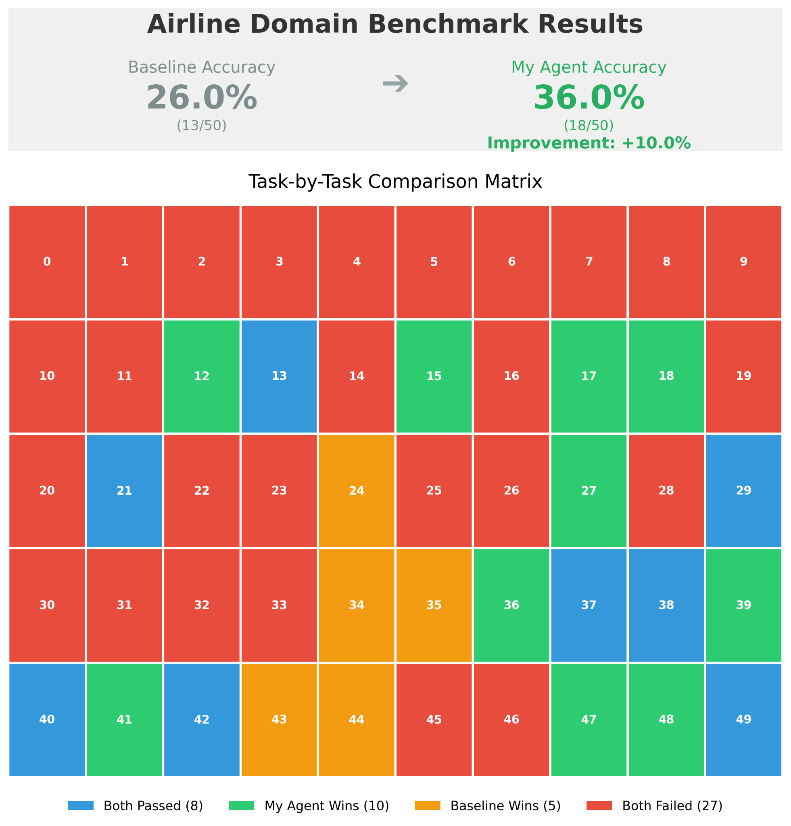
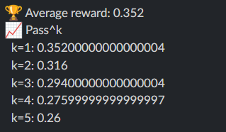
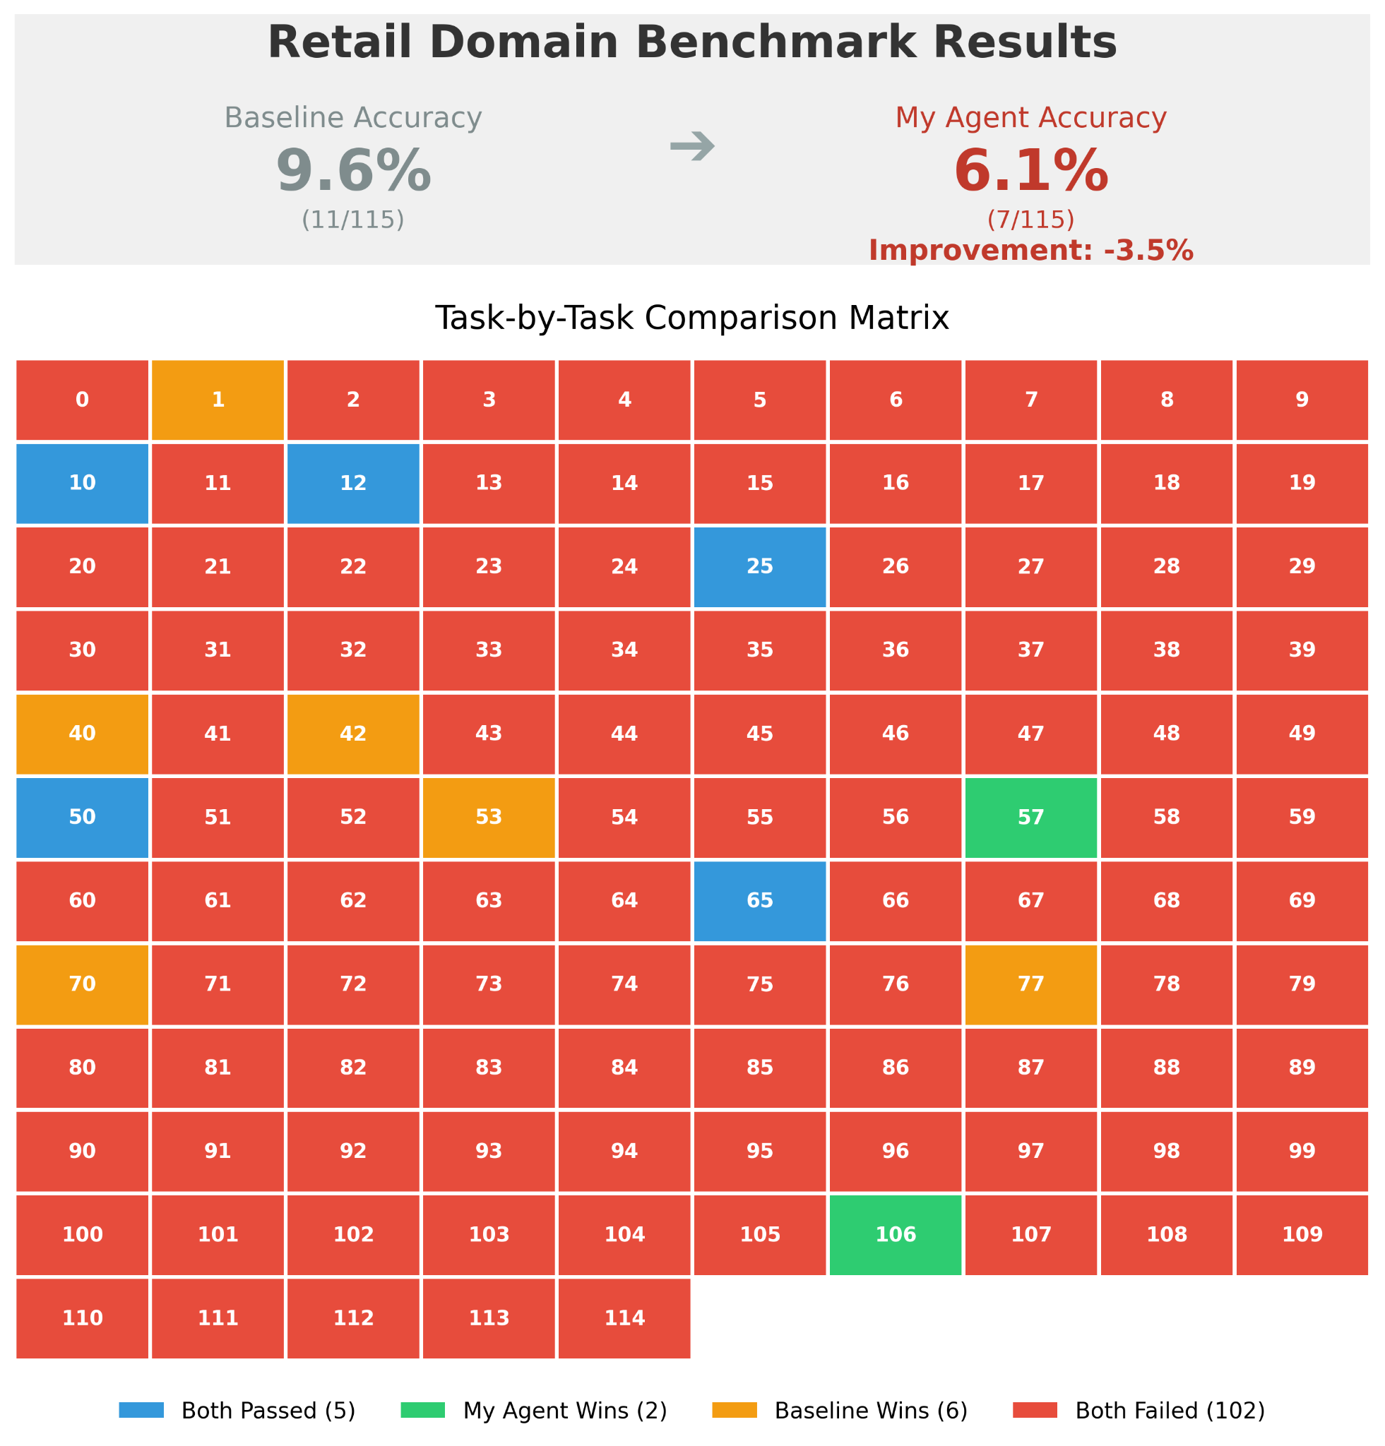
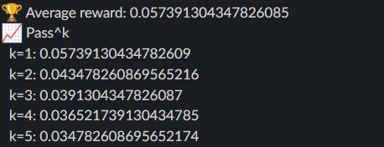
Results
Pass^k values: for Airline Domain
There was ~10% improvement in the scores when using budget forcing with the tau-bench airline domain
Pass^k values: for Retail Domain

Slide 14
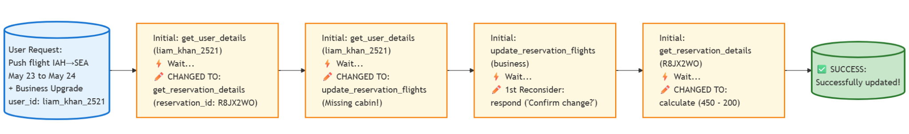
Example & Observations
Observations:
Policy observations for both domains revealed that the retail domain policies were much stricter than the airline domain policies
Ex. Some tools could only be called once, authenticating the user correctly and multi constraint verification
Improvements:
Domain specific prompt injection to induce valuable reconsideration
Adaptive budget forcing based on criticality of actions

Slide 15
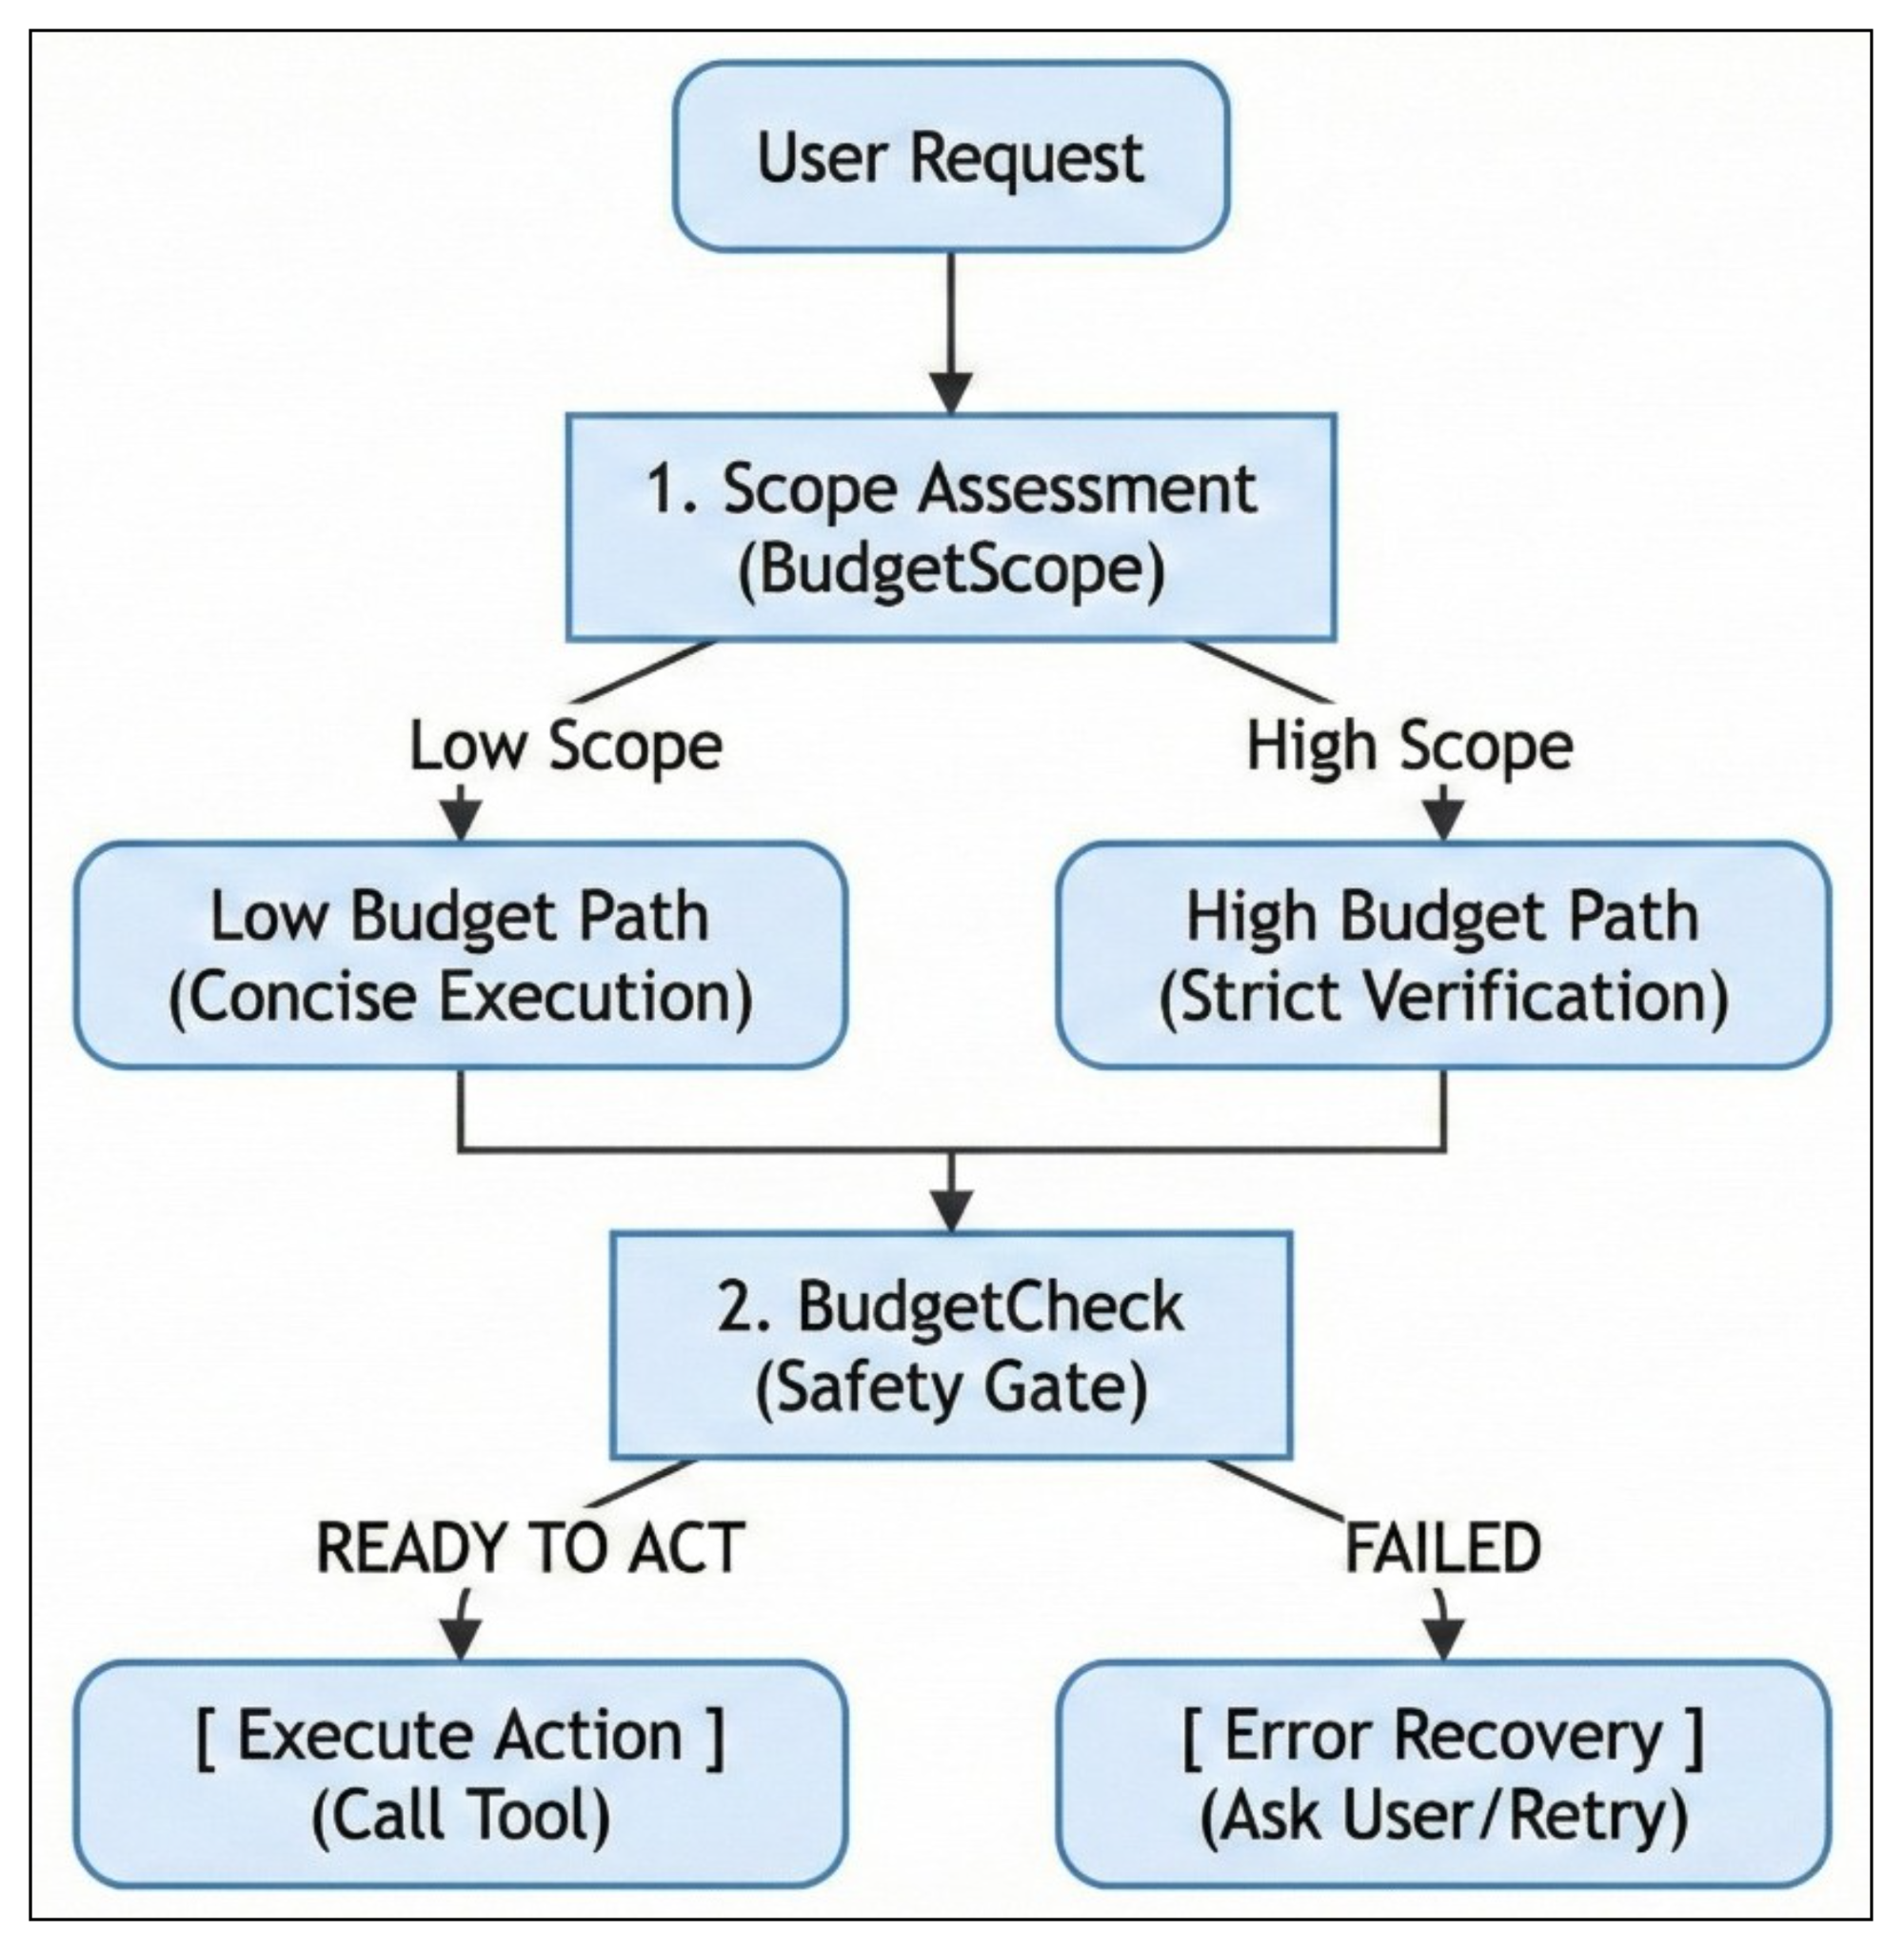
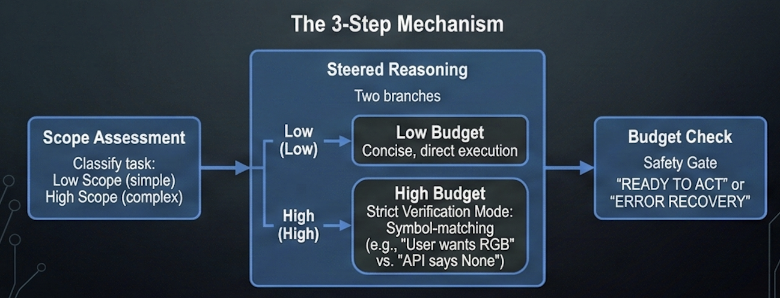
Method : Dynamic Budget Steering
Dynamic Budget Steering (DBS): A prompt-based control mechanism that forces agents to assess task complexity before acting

Slide 16
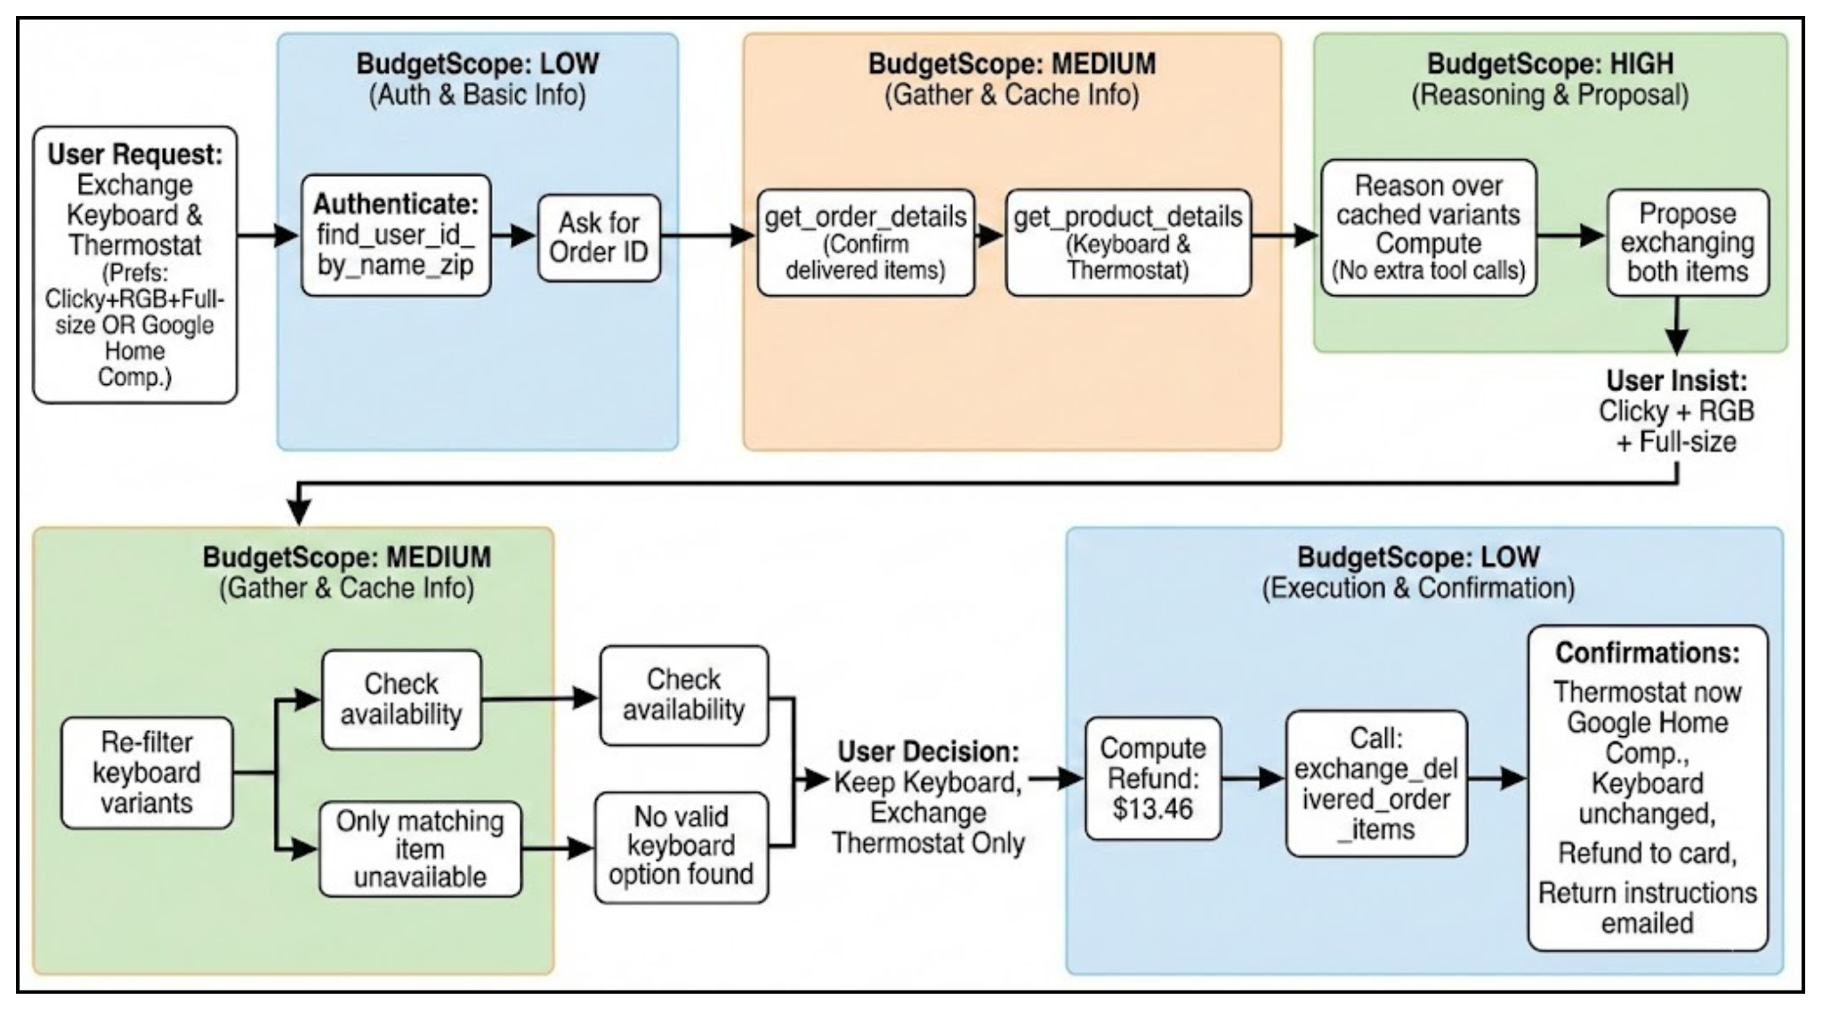
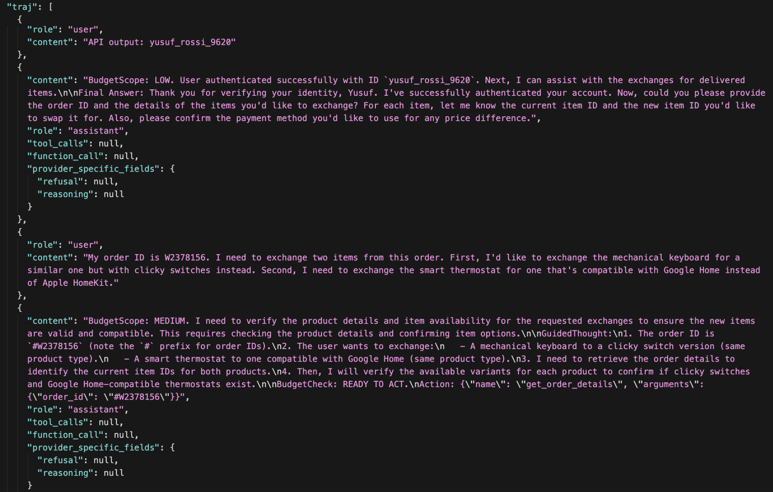
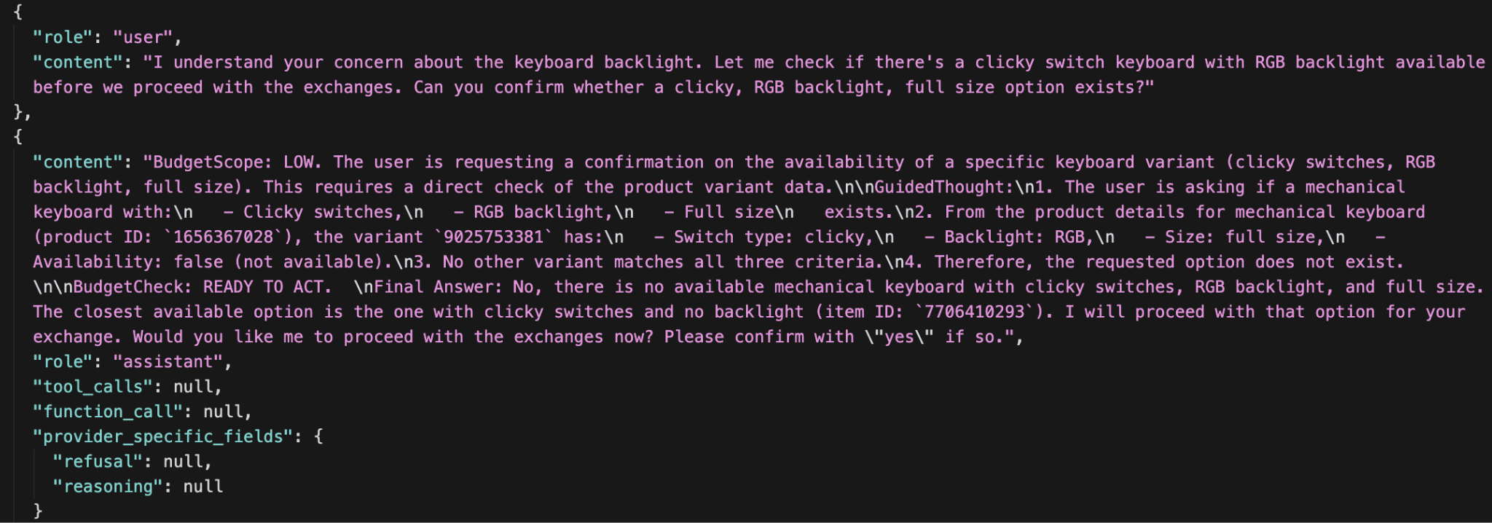
Example

Slide 17
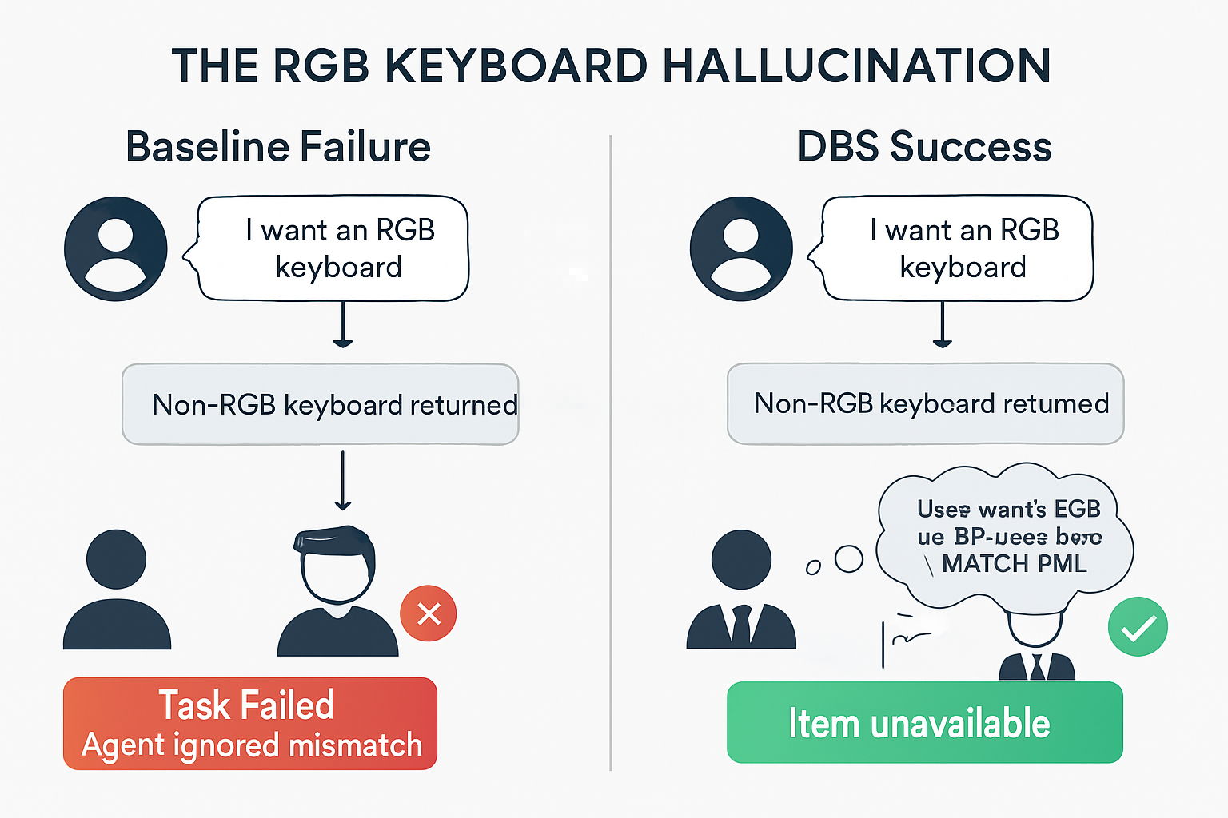
Qualitative Analysis
Example: "The 'RGB Keyboard Hallucination."
Baseline Failure: User asked for an RGB keyboard. The tool returned a non-RGB one. The Baseline agent ignored the text and exchanged it anyway (Task Failed).
DBS Success: The DBS agent used High Budget Mode, explicitly wrote "User wants RGB vs. API says None -> MATCH FAIL," and correctly told the user the item was unavailable.

Slide 18
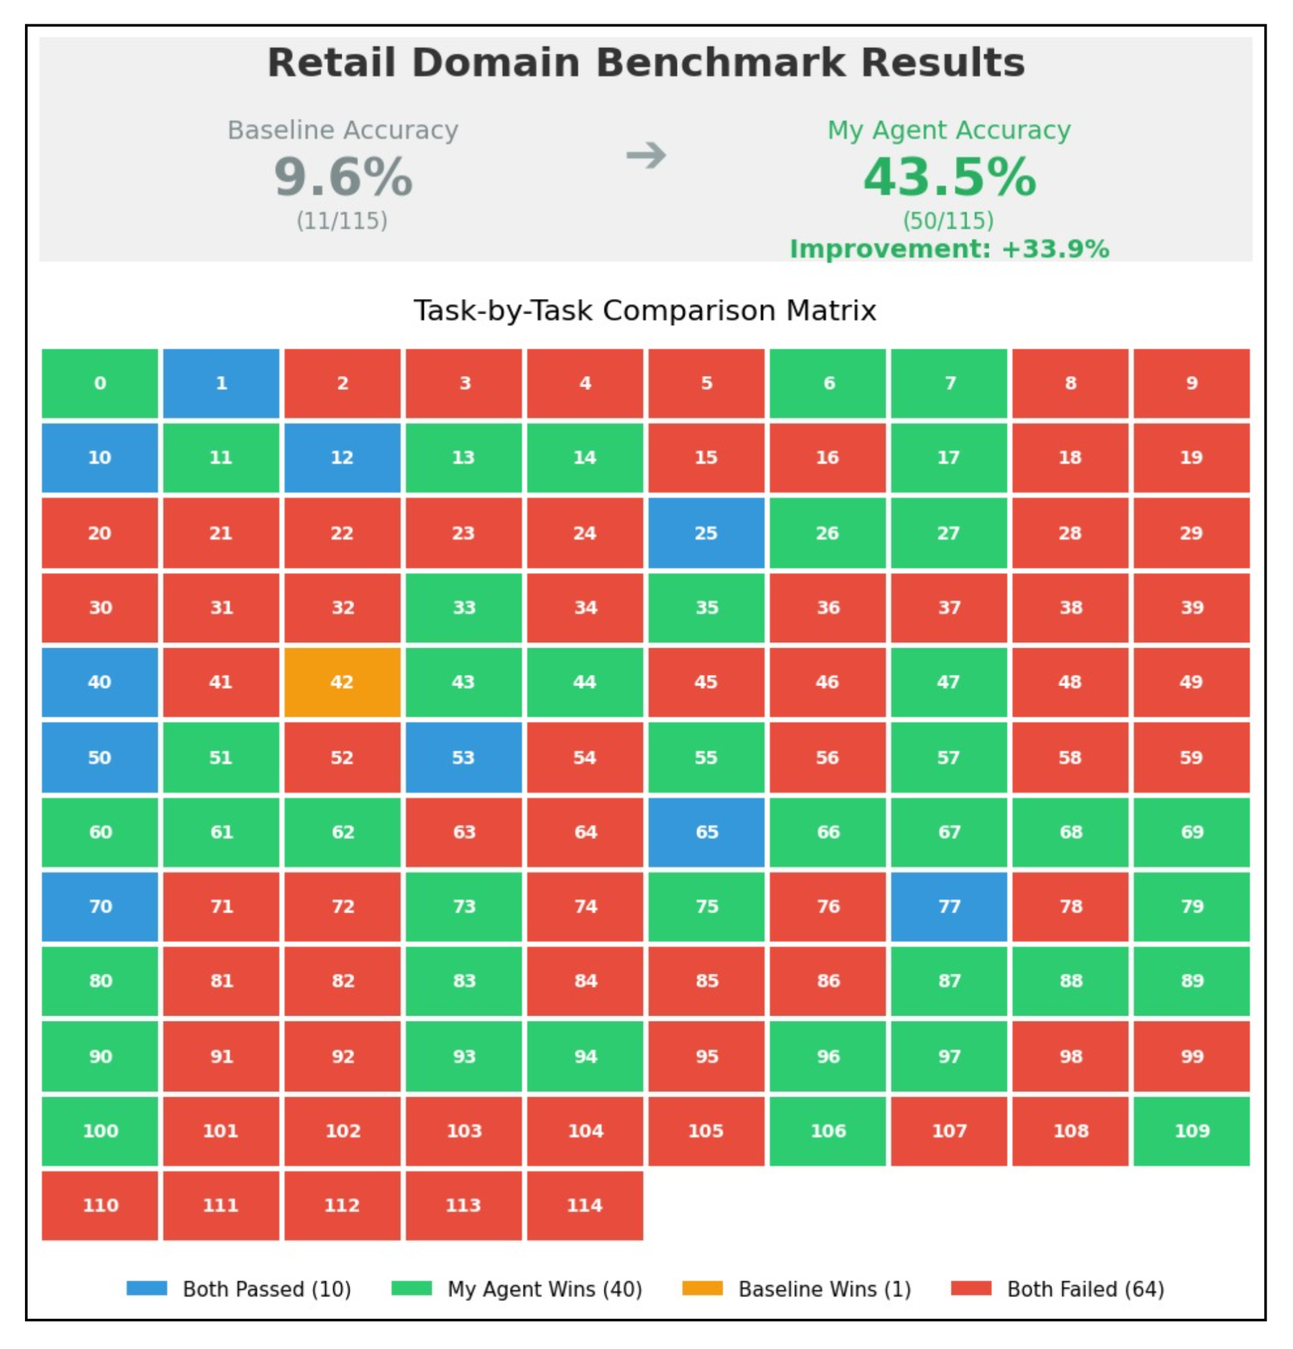
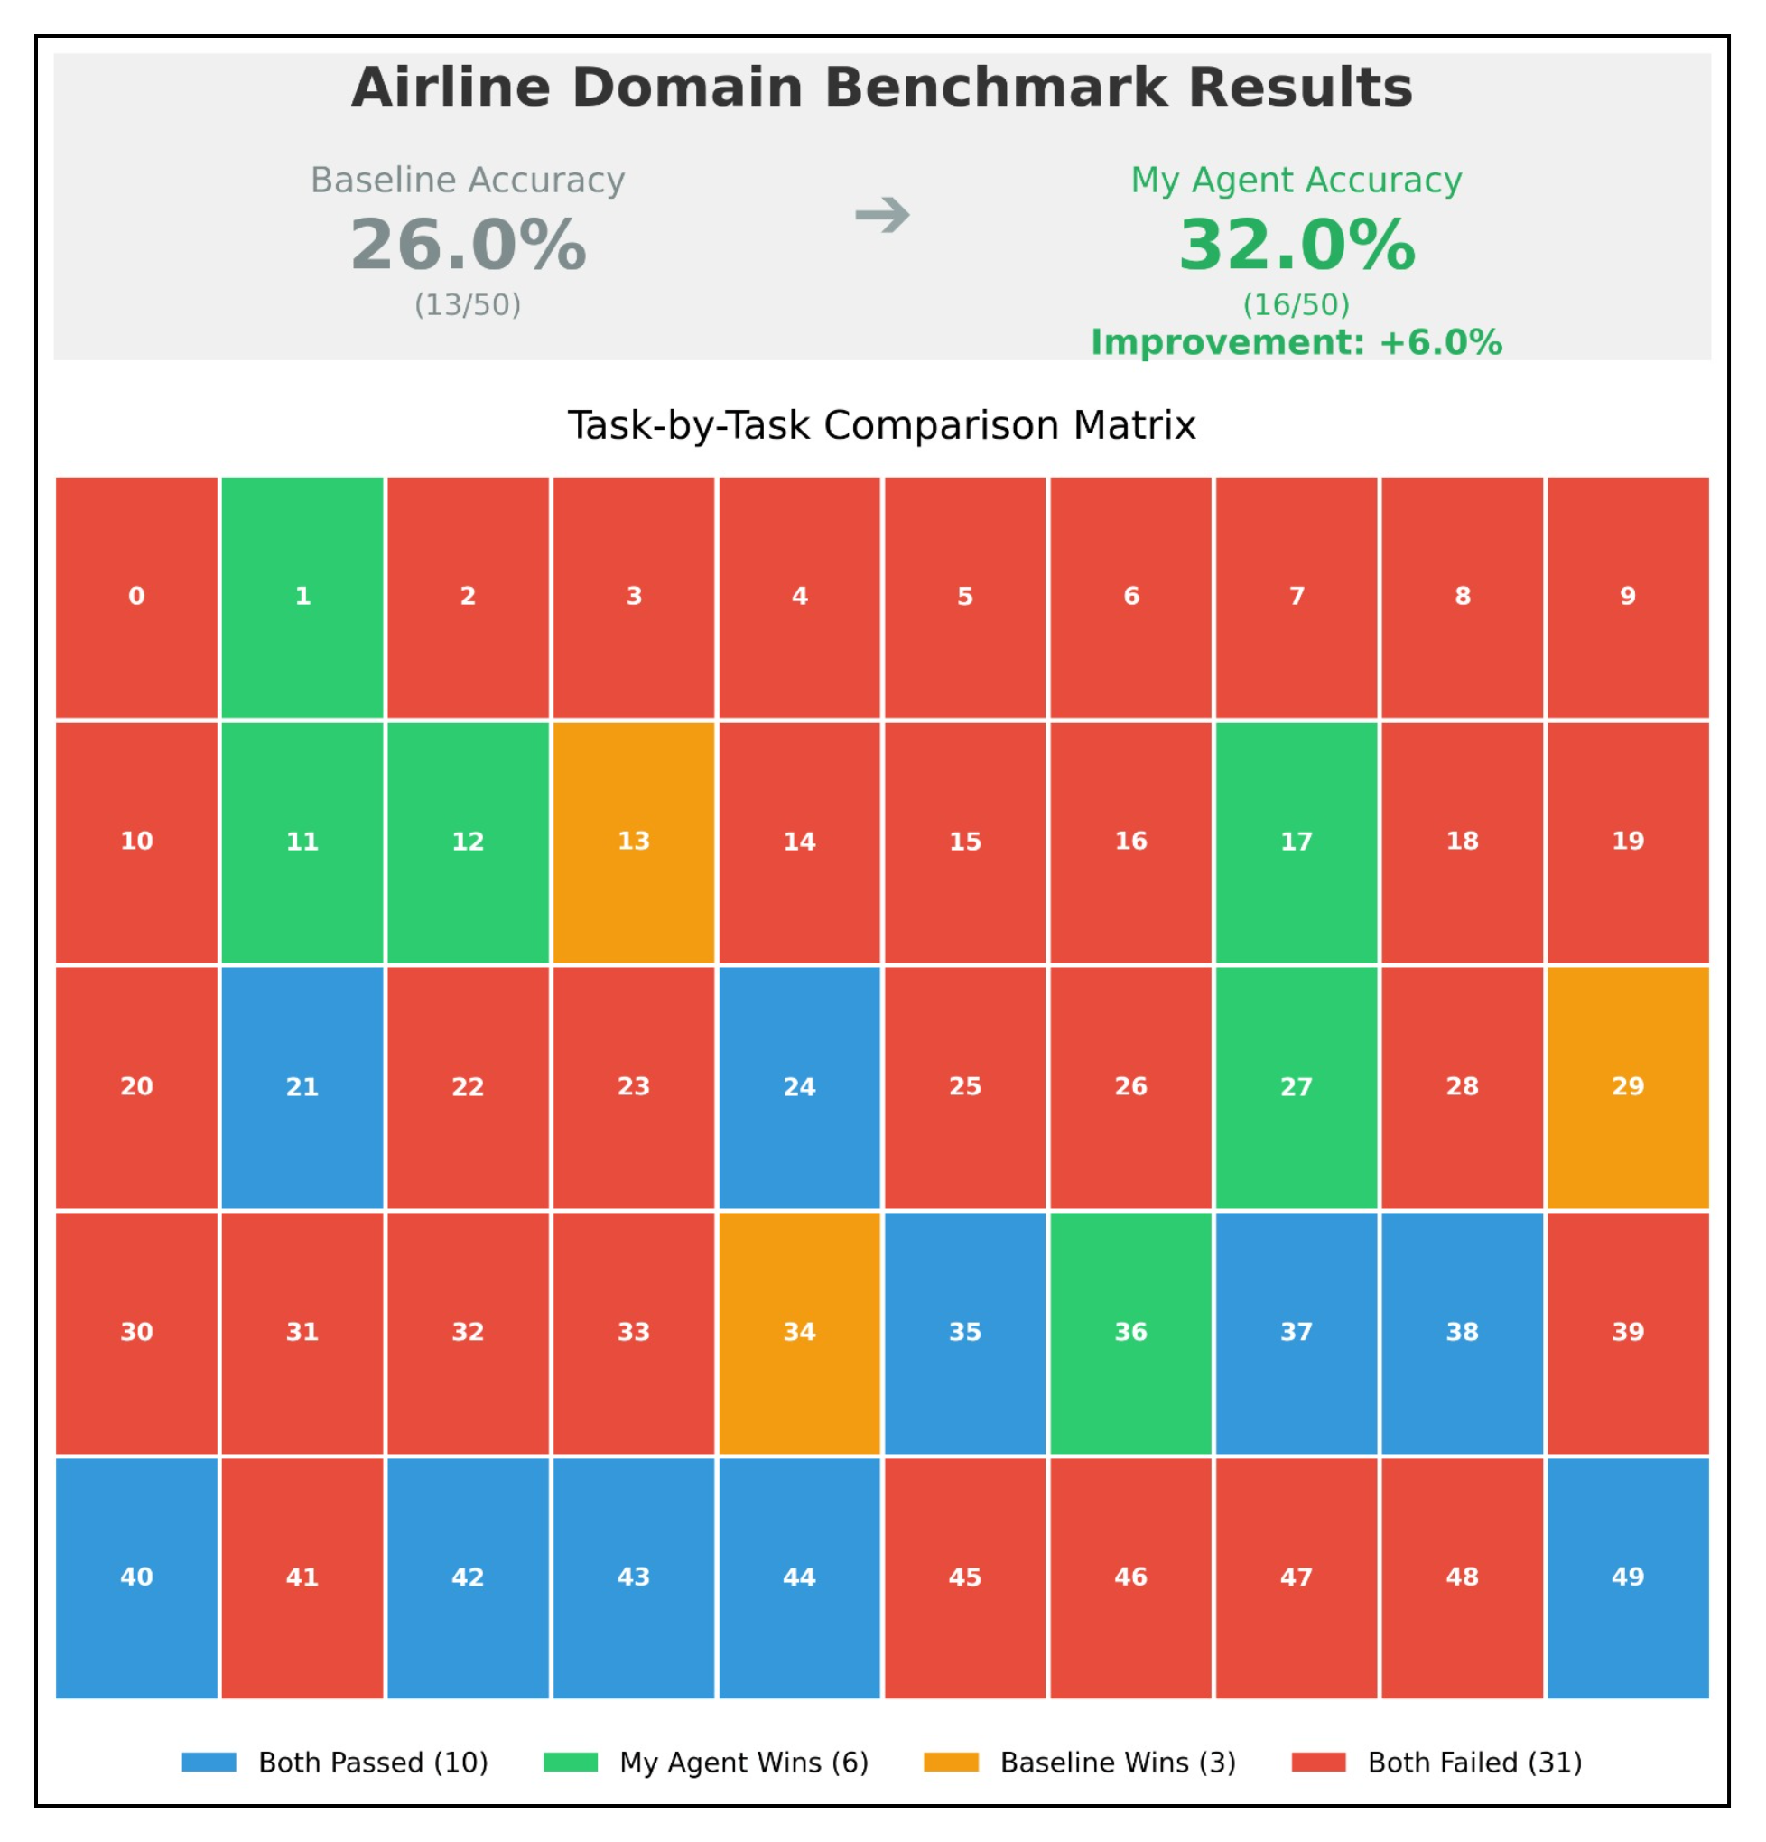
Experimental Findings

Slide 19
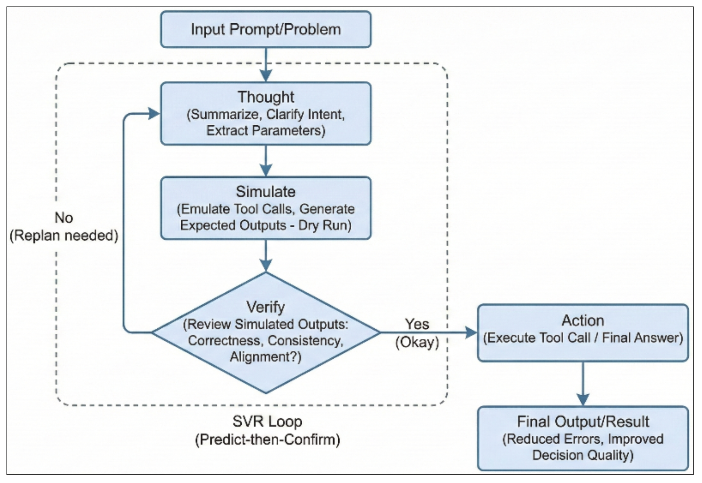
Method : Simulate-Verify-Replan
Simulate–Verify–Replan (SVR) Inference-time reasoning loop to simulate and validate actions before execution.
How SVR Works: • Simulate: Model predicts the expected action & it’s outcome before acting. • Verify: Checks for rule violations, missing arguments, and alignment with user intent. • Replan: If verification fails, model asks clarifying questions or adjusts reasoning. • Act: Only executes the action after the simulation passes verification.

Slide 20
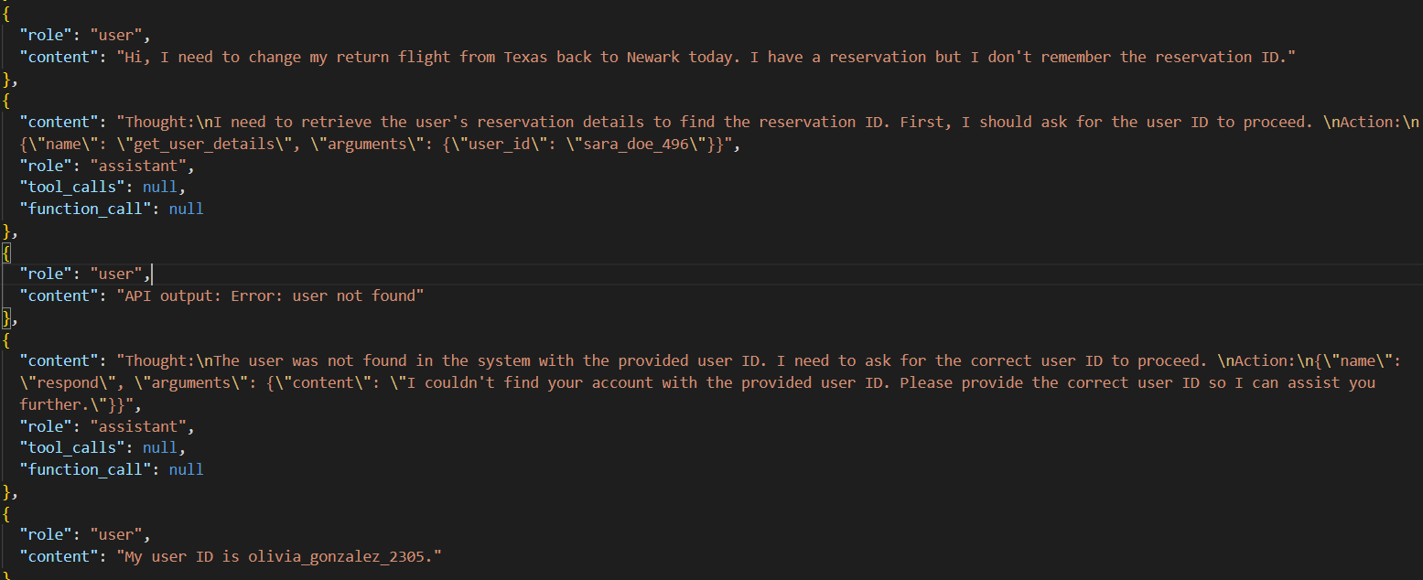
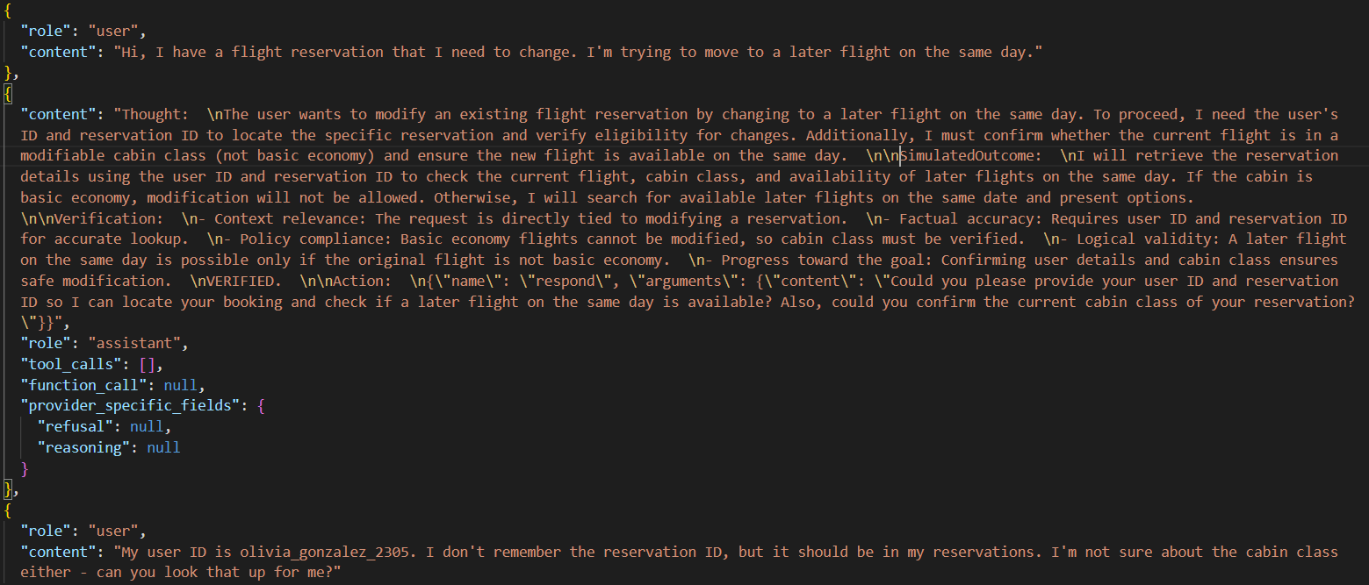
Example Comparison
BASELINE
SIMULATE-VERIFY-REPLAN

Slide 21
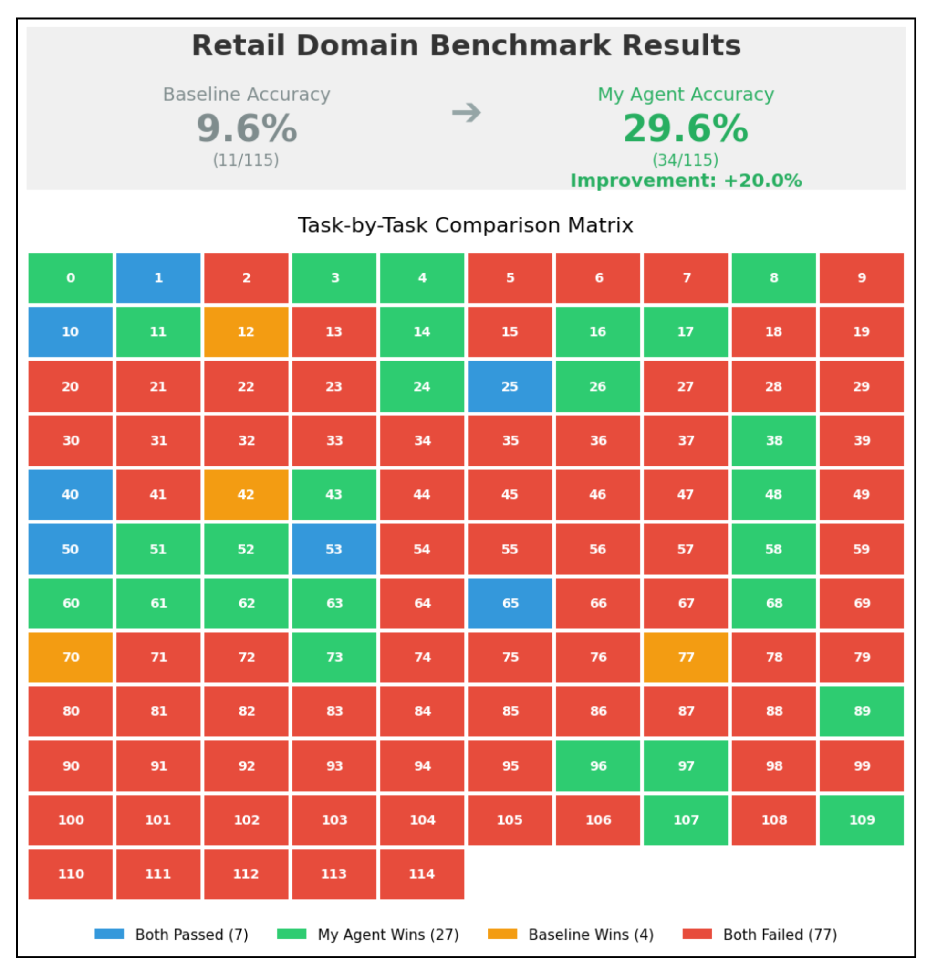
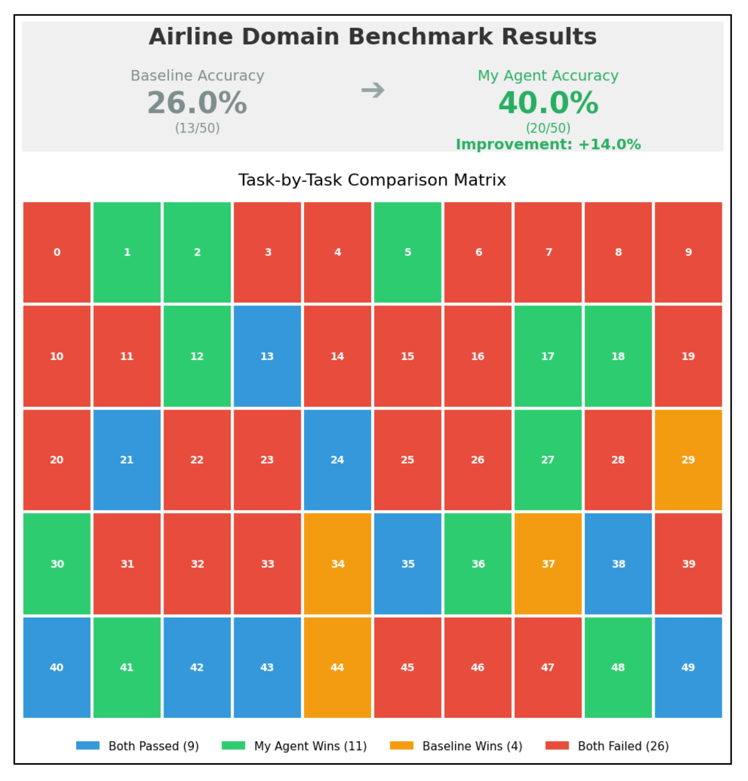
Experimental Results

Slide 22
Conclusion
Agent Model: Qwen 3 4B Instruct
User Model: Claude 4.5 Sonnet
Key Improvements:
Retail: 43.5% ↑ vs Claude-3-Sonnet 26.3%
Airline: 40% ↑ vs GPT-4o 35.2%
What This Shows
Improvements come from smarter test-time strategies, not size
Structured self-checking enables consistent, rule-abiding behavior
SVR + DBS provide strong reliability in complex, multi-step tool-use settings
Takeaway
We don’t just need bigger models - we need smarter reasoning. With the right inference-time structure, small models can achieve large-model reliability.

Slide 23
Summary
Key Message
Reasoning structure at test time matters more than model size for reliable tool-using agents.
What We Learned Across All Methods
Best-of-N → improves reasoning diversity
Test-Time Interaction → increases decision refinement
Budget Forcing → reconsiders if the initial action is correct else changes action if required
DBS → adjusts depth of reasoning based on task complexity
SVR → ensures actions are logically verified before execution
Core Insight
Improving inference-time reasoning leads to more robust, policy-following, multi-step-capable agents.

